Slide 1
Mini Project – 1

Slide 2

To-do list
A task manager you can trust

Slide 3
TEAM Our Team Members
M Nikhil Narasimha 737-025
M. Pawan Kalyan 737-027
R. Srujan Teja 737-046

Slide 4
Introduction
Every day we have thousands of thoughts running in our head, we feel like to grasping and trying to remember everything we’ve thought, but thoughts seem to slip away (it’s obvious) here comes the TO-DO LIST, as soon as we write down the thoughts scrambling around our head, we feel a sense of relief, your brain stops stressing about remembering everything, we can become more organized.
We can make it more flexible using latest technology

Slide 5
Abstract
Python being a powerful, flexible and easy to use language, offers powerful and efficient foundations for supporting projects​​
In our "To do list" project we used Tkinter for GUI
The UI contains a box with list of tasks, buttons to add a new task or delete an existing task, the tasks are tagged with checkboxes, we can check off the completed tasks, the checked off tasks will be transferred to another box/list . There will be a priority bar displaying the high priority task.

Slide 6
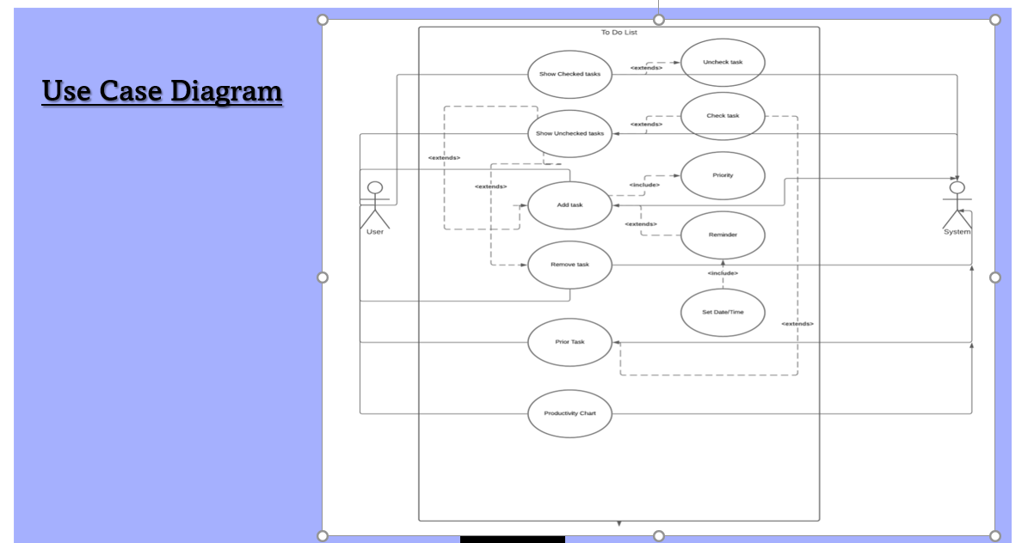
Features
User – friendly UI
Easy to use
Recurring tasks
Notes
Priority bar
Productivity Chart
Notifications (Not finalized)
Themes (Not finalized)
.

Slide 7
Technology Used
1) Software Requirement (Our Side)
a) Pycharm Application with Python software pre-installed
b) Installation of Modules like Tkinter, Numpy, Matplotlib, and Sqllite3
c) User will need any basic Windows version like XP to run this application
2) Hardware Requirements
a) Memory : 500MB
b) Graphics : Graphic card is not mandatory
c) CPU : Intel Core 2 Duo U7600 2.00Ghz or Above
d) OS : XP or above

Slide 8
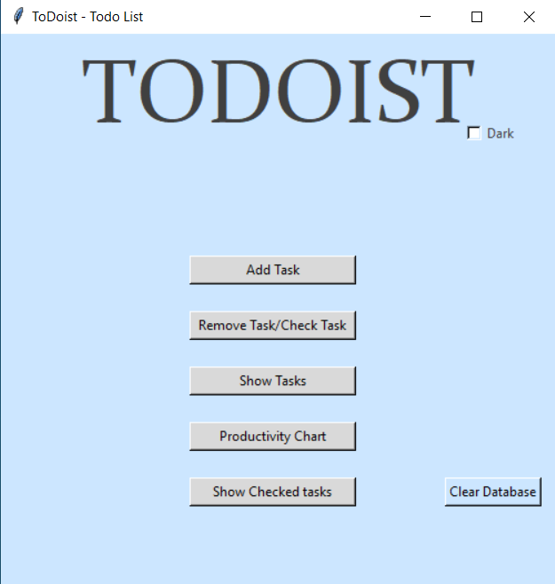
Future scope
As we grow increasingly more connected through technology and social media, it is becoming more and more difficult to organize our lifestyle.
In this fast-changing world we are always busy, we become more busier as time passes, there arises the need of a to do list.
When we are often overwhelmed with tasks, writing them down makes our mind less stressed, it helps in increasing memory, prioritizing, and helps in increasing productivity.
They dampen anxiety about the chaos of life; they give us a structure, a plan that we can stick to; and they are proof of what we have achieved that day, week or month.
We believe this will a great tool for people living in this fast-changing corporate world to enhance their productivity

Slide 9
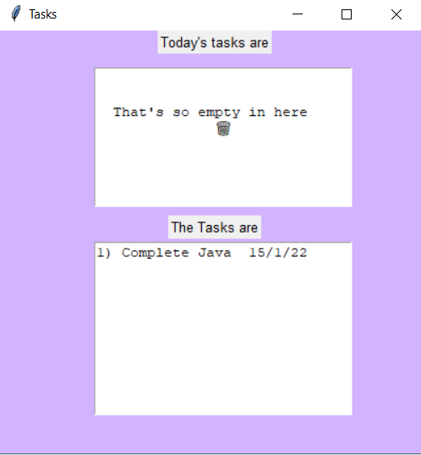

“Let's focus on what matters the most”

Slide 10

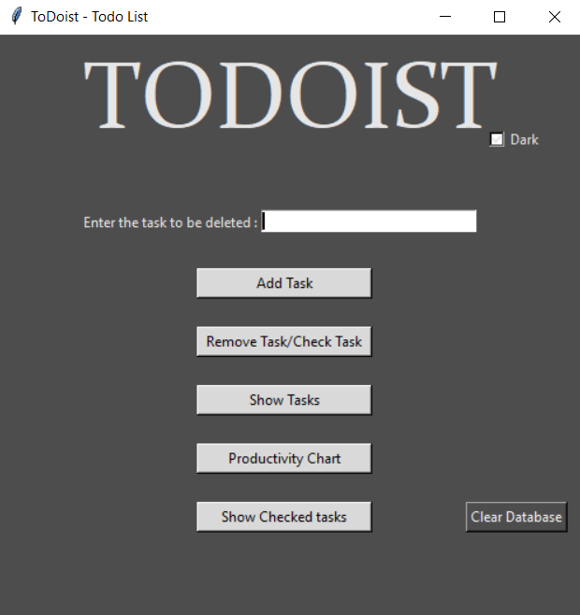
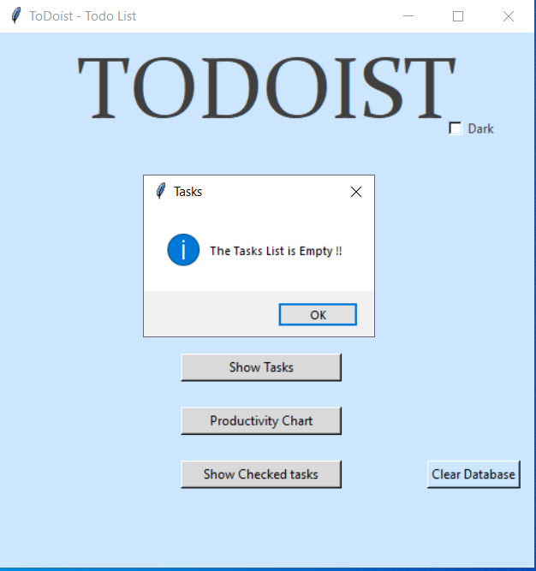
THANK YOU!
Presentation

Slide 11
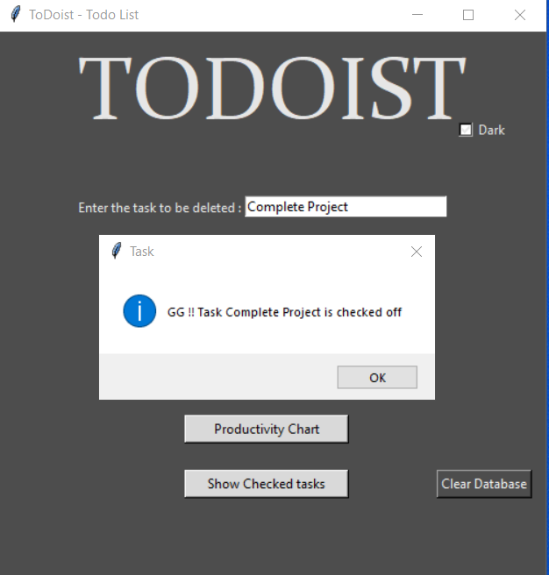

Slide 12
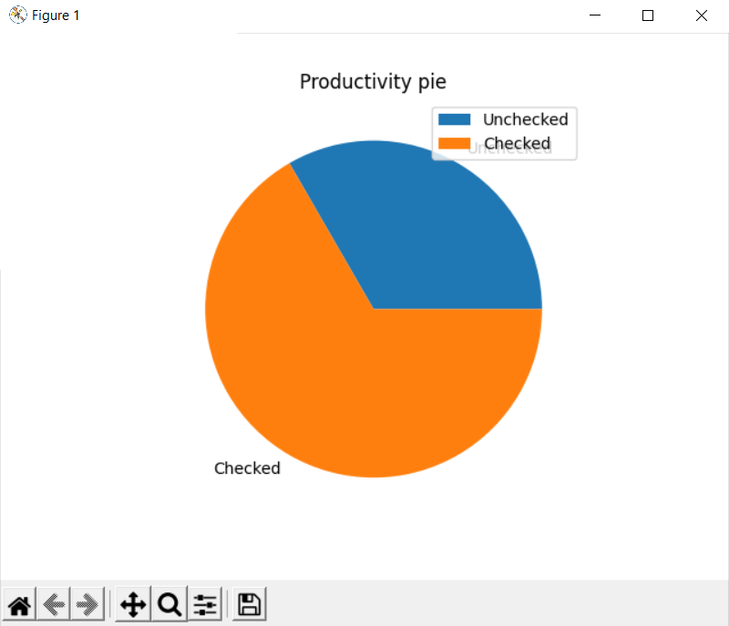

Slide 13
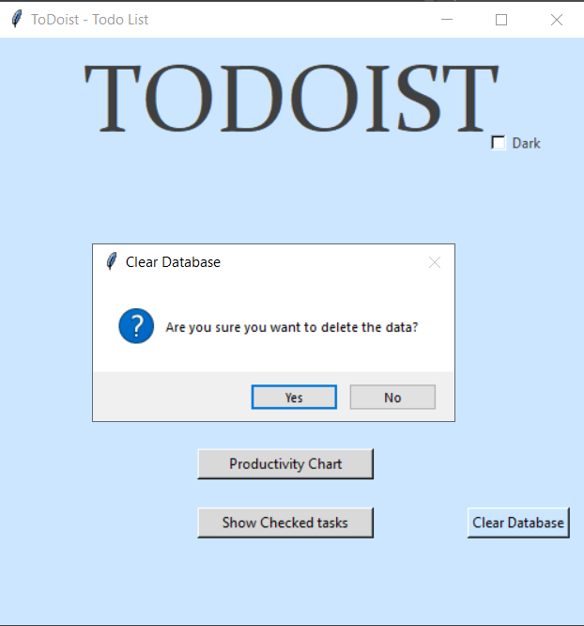

Slide 14
Conclusion
In this Mini Project we have successfully implemented a To-do List application using Python and its Libraries Tkinter and Sqllite3 especially
Now a days we are bombarded with lots of tasks to do, we often get lost and forgot most of the things we had to in the first place, so using a ToDolist will enhance productivity and help you organize better
In our application the user can enter the tasks, delete the tasks, add a respective date to view daily tasks, view the productivity chart…etc.
The tasks entered will remain forever even though the application is killed and ran again.

Slide 15
Conclusion
Everything in our project performed as planned and our team meets the goals outlined in the description. We designed a To Do List using python.
We are highly indebted to our faculty who continuously supported us throughout the journey..

Slide 16
Future Work
We would like to add a login system, Calendar which shows tasks of respective days, notifications, notes, recurring tasks, and develop the GUI to the newer levels

